Slide 1
Tags Controller and Program
© 2012 John Sefcovic.

Slide 2
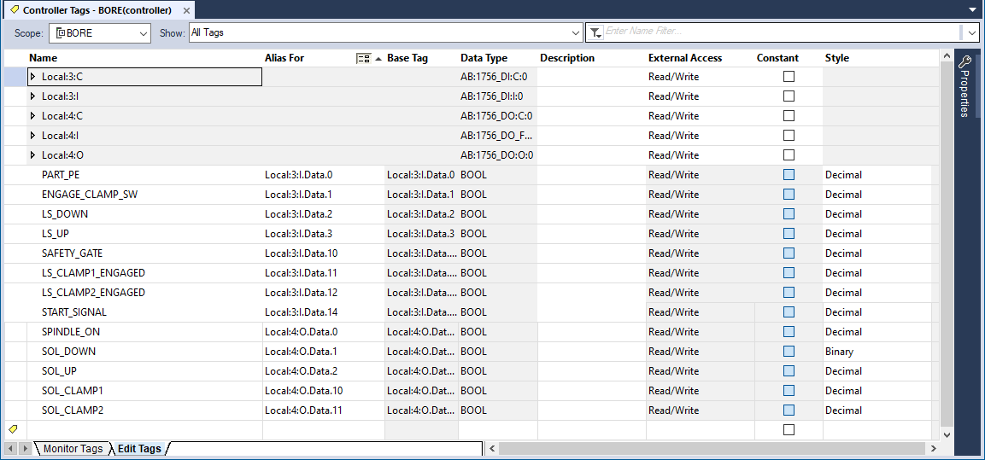
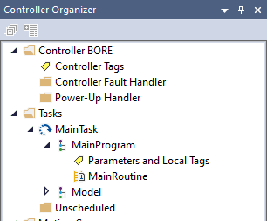
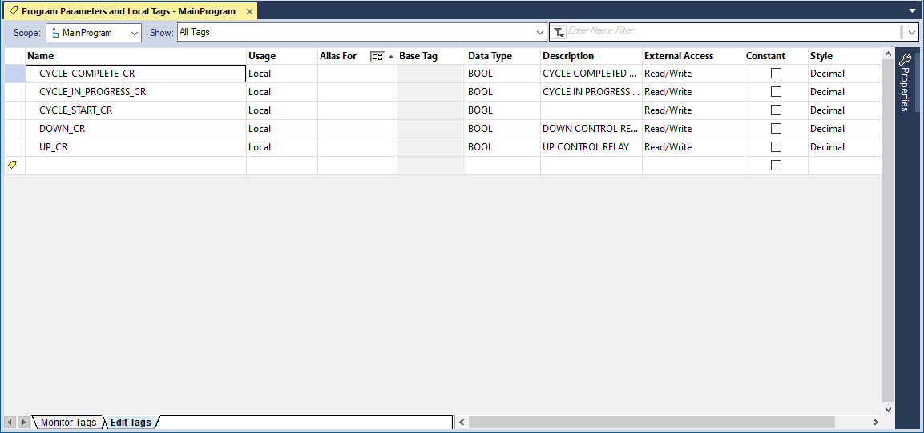
Tag Types
Controller Tags
Program Tags
Program Tags labeled in the Controller Organizer as Parameter and Local Tags.

Slide 3
Tag Dialog Tabs
At the bottom of the Controller and Program Tag dialogs are two tabs:
Edit Tags – to enter or modify tag information.
Monitor Tags – to view tag values and for force functions.

Slide 4
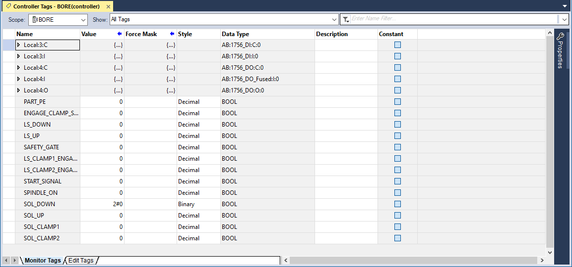
Tag Dialog Tabs
Edit Tags is where the Tags are named has the columns to assign the Alias and for the Base reference.
Monitor Tags has the columns for tag Value and Force status.

Slide 5
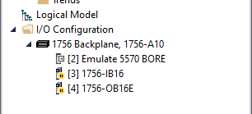
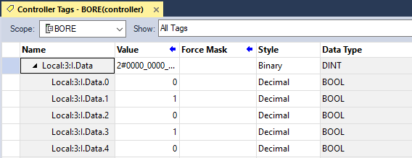
I/O Controller Tags
Input Module in Slot 3
In this example to Monitor Tags, the Input Module is in Slot 3.
By expanding the Local (Slot 3).I (Input).Data (Structure) the .num (Bit) the value at the Address can be viewed.

Slide 6
I/O Controller Tags
The Monitor Tags screen shows the current Value at the Input (or Output) hardware Address are shown for troubleshooting.
0 is no voltage.
1 is voltage.

Slide 7
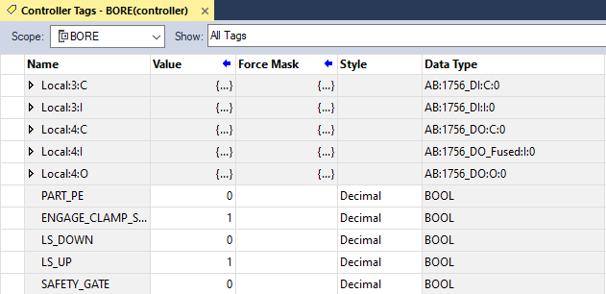
I/O Controller Tags
The descriptive Alias Names assigned to the Hardware Address can also be viewed in Monitor Tags for troubleshooting.
0 is no voltage.
1 is voltage.

